Slide 1




Sales and Promotion
Analysis
By Rashi Singla

Slide 2

Content
Problem Statement
Objective
Analysis
Store perfromance Analysis
Promotion Type Analysis
Product and Category vise Analysis
Ad_Hoc_Request
Conculsion

Slide 3




Problem Statement
AtliQ Mart, a prominent retail giant , Operates 50 supermarkets accross the southern region of India.
During the festivals periods of diwali 2023 and sankranti 2024, AtliQ Mart conducted extensive promotions on their Atliq branded product accross all the 50 stores.
The sales director is seeking a comprehensive analysis to distinguish the success levels of these promotions.
The primary objective is to identify the promotions that performed well and those that did not, enabling informed decision making for the future promotion strategies.

Slide 4




Objectives
Evaluate the success of AtliQ Mart's Diwali 2023 and Sankranti 2024 promotions.
Identify factors contributing to the effectiveness of each promotion.
Provide insights for informed decision-making in future promotional planning.
Optimize resource allocation based on the analysis for enhanced performance.

Slide 5

Store
Performance
Analysis

Slide 6
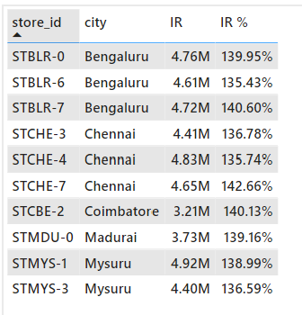
Which are top 10 stores in terms of Incremental Revenue (IR) generated from the promotion?
Here are the Top 10 stores by generate the Highest Incremental Revenue. Mainly These Stores is Located in Tier 1 cities that is Bangalore , Chennai etc.
The most IR is generated by Combo 1 Category product sales all these stores.

Slide 7
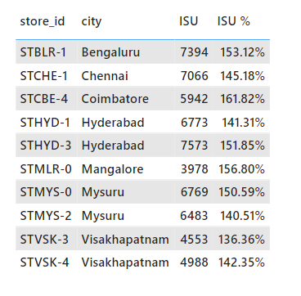
Which are Bottom 10 stores when it comes on Incremental Sold units (ISU) during the promotion period?
Here are the Bottom 10 stores by Incremental Sold units(ISU). Mainly these Stores is Located in Hyderabad, Visakhapatnam etc.
The lowest ISU is generated by Personal care Category product sales all these stores.

Slide 8
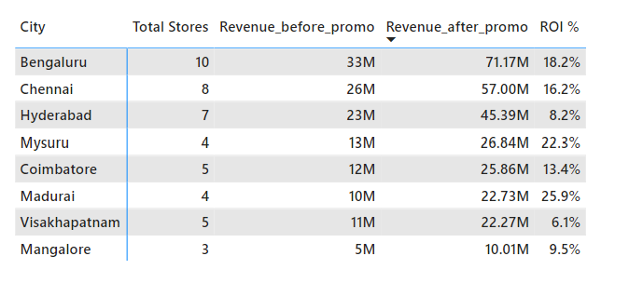
How does the performance of stores vary by city? Are there any common characteristics among the top performing stores that could be leveraged across other stores?
Total number of stores present in all over cities are 50.
The Top 3 Cities are present the highest no. of stores are in Bengaluru, Chennai and Hyderabad.
The top Stores mainly generate their revenue from the combo 1 and grocery category.
The Highest ROI % is generated in Madurai and Mysuru city with the same no. of stores.

Slide 9



Promotion
Type
Analysis

Slide 10
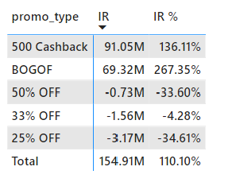
What are the top 2 promotion types that resulted in the highest incremental revenue?
The TOP 2 Promotion types in terms of their impact on incremental Revenue by BOGOF & 500 Cashback.
These 2 promo types generate positive IR and other promo types generate negative IR.

Slide 11
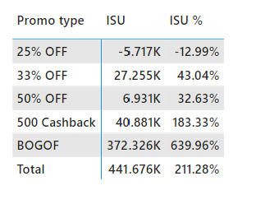
What are the bottom 2 promotion types in terms of their impact on Incremental Sold units?
The Bottom 2 Promotion types in terms of their impact on incremental sold units by 25% OFF & 50% OFF.
These 2 promo types create hardly 10 % of sales.

Slide 12
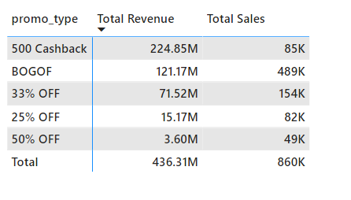
Is there a significant difference in the performance of discount - based promotion versus BOGOF or Cashback promotions?
So, the Cashback & BOGOF Promo type perform better than the Discount based Promo type.
The More than half of sales & Revenue is generated by Cashback & BOGOF compared to the discount based types.

Slide 13
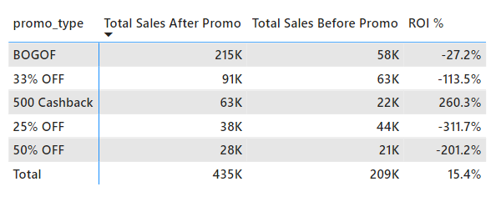
Which promotions strike the best balance between Incremental Sold units and maintaining healthy margins?
The best balance between ISU & Margin is created by 500 Cashback promo type. It means this promo type create more revenue comparatively.
The lowest margin is generated by 25 % off promo type. (More need to be focused)

Slide 14

Product &
Category
Analysis

Slide 15
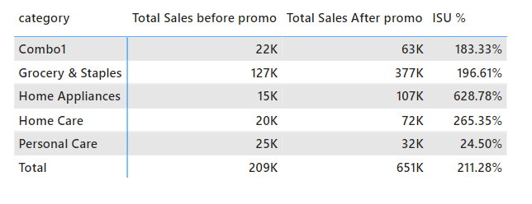
Which product categories saw the most significant lift in sales from the promotions?
There is most Significant lift in sales see in Home appliances and Grocery & staples category. It means mostly people love to by home appliance at the time of Festivals.
The least significant lift in sales of Personal care product its only 12 % overall(Total) ISU

Slide 16
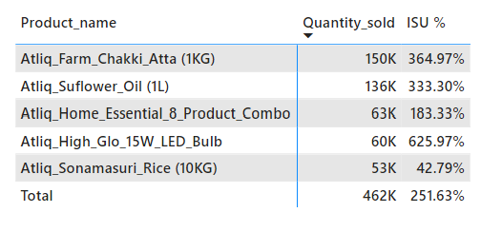
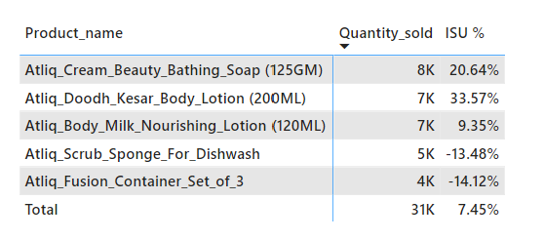
Are there specific products that respond exceptionally well or poorly to promotion?
Chakki Atta (1KG) leads the pack with the highest quantity sold (150K) and ISU% (364.97%). This suggests strong demand and potential for further promotion or upselling.
Sunflower Oil(1L) and Bulb follow closely with impressive ISU% (around 330% and 625% respectively), indicating good customer reception.
Body Lotion (200ML) and Dishwash shows the low sales (around 7K and 5K respectively) and negative ISU% requiring immediate attention and strategic changes.
Perform Exceptional well Products
Perform Poorly products

Slide 17
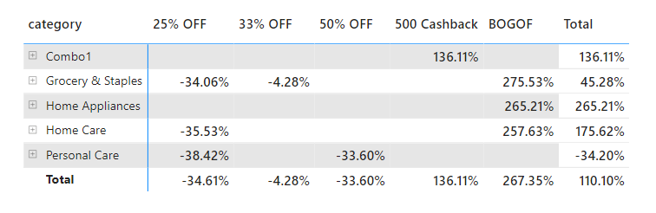
What is the correlation between product category and promotion types effectiveness?
BOGOF (Buy One, Get One Free) and 50% off discounts are the most prevalent across all categories, except for Combo1.
Discounts on Home Appliances and Home Care seem to be more prominent compared to other categories.
The BOGOF have a strong emphasis on attracting customers. That’s why highest of Revenue is generated by BOGOF promotion type

Slide 18

AD-HOC
Business
Request

Slide 19
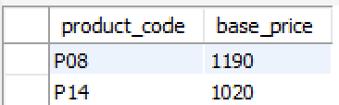
Business Request 1
Provide a list of products with a base price greater than 500 and that are featured in promo types of ‘BOGOF’.
These are 2 product(Double_Bedsheet_set, Waterproof_immersion_rod ) that are currently being heavily discounted comparativetly other products

Slide 20
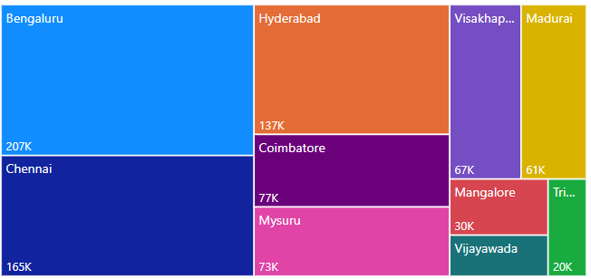
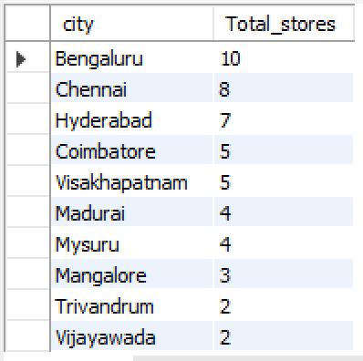
njdj
Business Request 2
Generate a report that provides an overview of the number of stores in each city.
Total Sales in each city
There is a positive relation correlation between the no. of stores in city and its total sales. Its means that the cities with more stores generate highest sales. However, there is also a factor that affect the total sales such as population of city, the average income of resident etc.

Slide 21
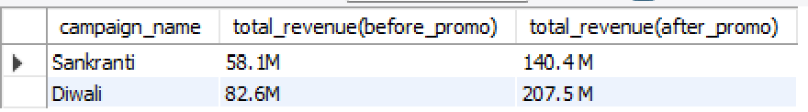
Business Request 3
Generate a report that displays each campaign along with the total revenue generated before and after campaign?
The Total revenue generated (after_promo) is approximately double the revenue before_promo. This suggests that promotion were successful in increasing sales.
The ROI of Diwali and Sankranti campaign is 78.8% and
-21.9% resp.

Slide 22
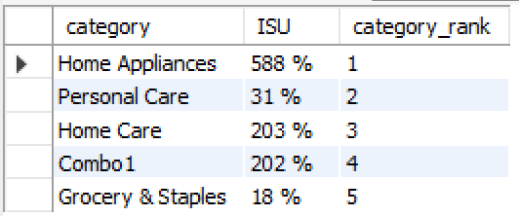
Business Request 4
Provide a report that calculate the Incremental Sold quantity (ISU%) for each category during the diwali campaign.
The Home Appliances is the most popular category with a 588 ISU%.
Personal Care and Grocery & staples are least popular category.
These are Top 5 Product(Home Essential, Bulb, Waterproof immersion rod , Curtains, Double Bedsheet) at the time of Diwali most people love to buy.

Slide 23
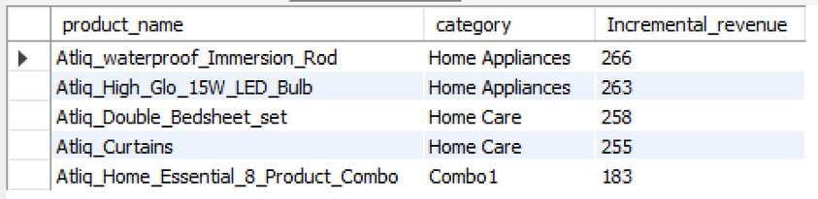
Business Request 5
Create a report featuring the TOP 5 products, ranked by Incremental Revenue percentage across all campaign.
These are Top 5 product ranked by Incremental Revenue. Home appliances and Home care products are the most represented categories among the top 5 products.

Slide 24

Conculsion
Highest Revenue and Sales is generated by BOGOF and cashback offer comparatively discount type offers.
The 25 % off promo type perform the lowest. Hence, we need to focused on products mainly which product we gave the 25 % off.
There are the personal care products are performed very less in sales may be because of festival season.
The best product category of this campaign is home Appliances and home care also this category perform exceptional after the promotion. The 50% of overall sales or revenue is generated by this category.
The 50% of revenue is generated in Bengaluru, Chennai and Mysuru.

Slide 25


